Slide 1
Mining Cross-Image Semantics for Weakly Supervised Semantic Segmentation ECCV2020 oral
Guolei Sun¹, 􏰟Wenguan Wang¹, Jifeng Dai², and Luc Van Gool¹
¹ ETH Zurich ² SenseTime Research ³ Qing Yuan Research Institute, Shanghai Jiao Tong University
https://github.com/GuoleiSun/MCIS_wsss

Slide 2
Weakly Supervised Semantic Segmentation
weaker forms of supervision: bounding boxes, scribbles, points, and image-level labels

Slide 3
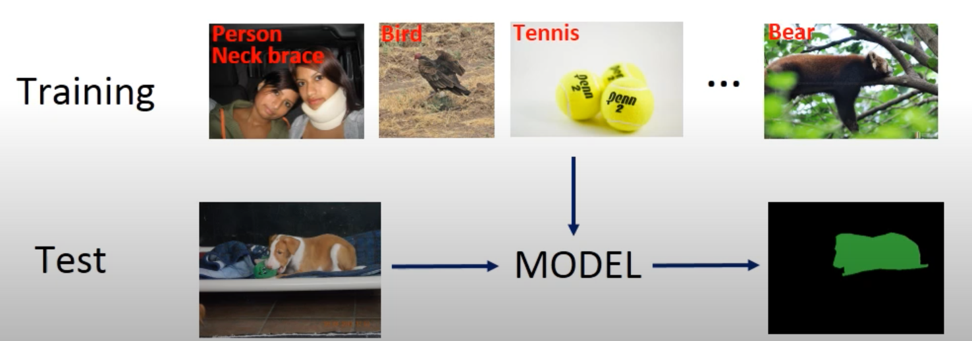
Problem setting

Slide 4
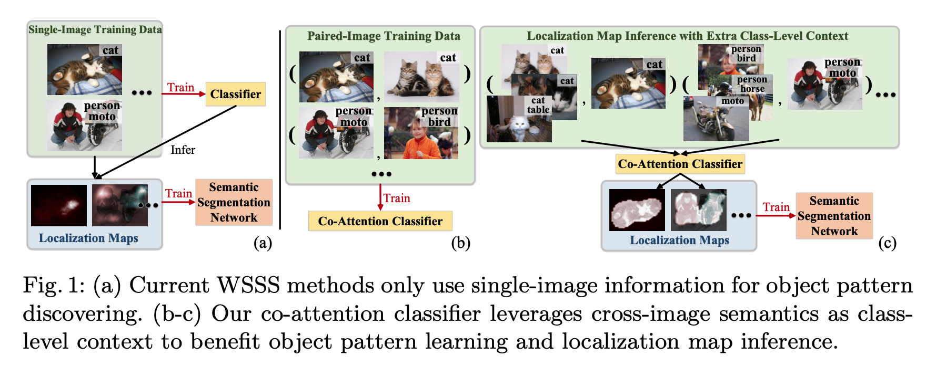
Current methods
Pipeline: train classifier by single-image data, generate pseudo GT, and then train fully segmentation network
Struggle to make the localization maps capture more complete object content

Slide 5
Limitations
Only intra-image information is used
Rich cross-image relation is ignored

Slide 6
main idea
Exploit cross-image semantics for complete object pattern mining

Slide 7
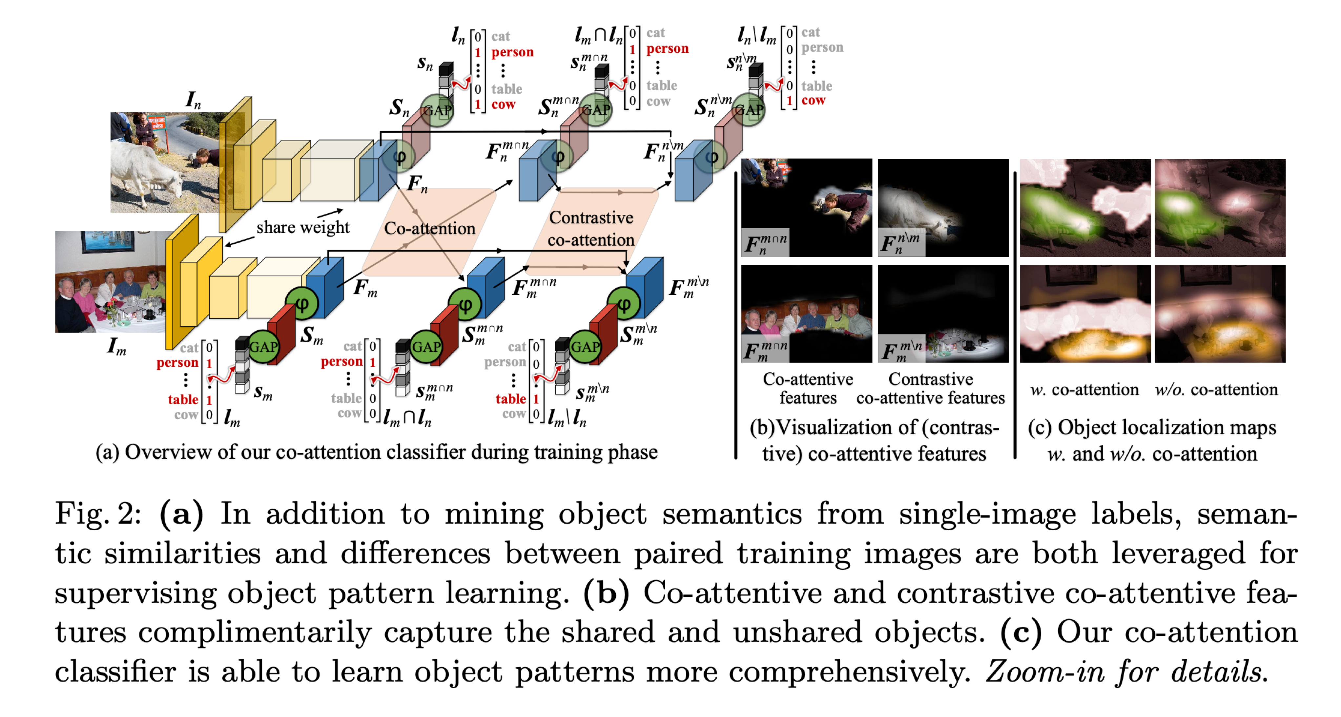
Methodology
Siamese network is used to mine the relation between image pairs
Co-attention: mine the cross-image common semantics
Contrastive co-attention: mine the cross-image exclusive semantics

Slide 8
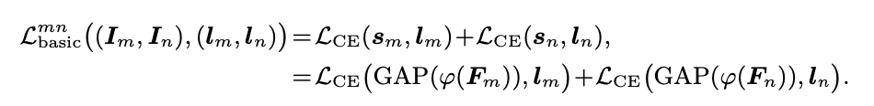
Methodology
Basic classifier: individual-image information is explored
Siamese network
Sigmoid cross entropy

Slide 9
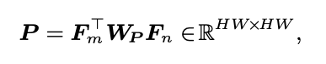
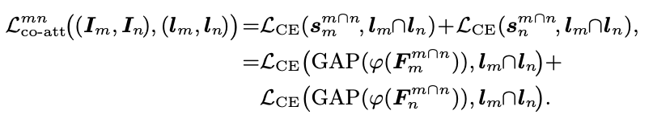
Methodology
Co-attention: mine the cross-image common semantics
Affinity matrix
Co-attention matrix
Co-attention features
Co-attention loss

Slide 10
Methodology

Slide 11
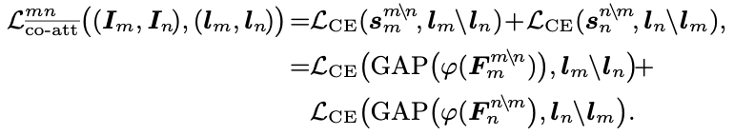
Methodology
Contrastive co-attention: mine cross-image exclusive semantics
Class-agnostic co-attentions
Contrast co-attention matrix
Contrast co-attention features
Contrast co-attention loss

Slide 12
Methodology

Slide 13
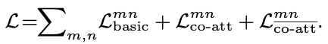
Methodology
Overall loss
In-depth discussion
Auxiliary-task learning: predict the common and uncommon semantics
Image co-segmentation: use knowledge of images shared/unshared semantics

Slide 14
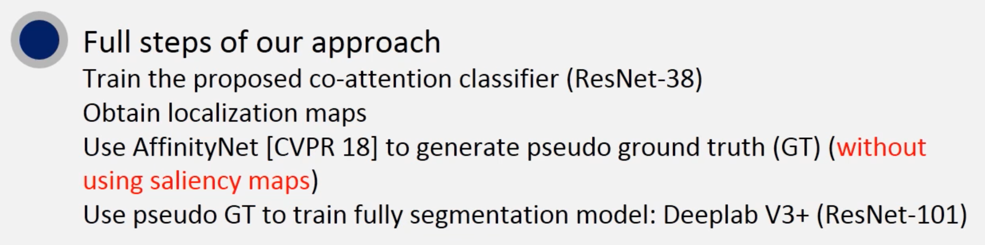
Methodology

Slide 15
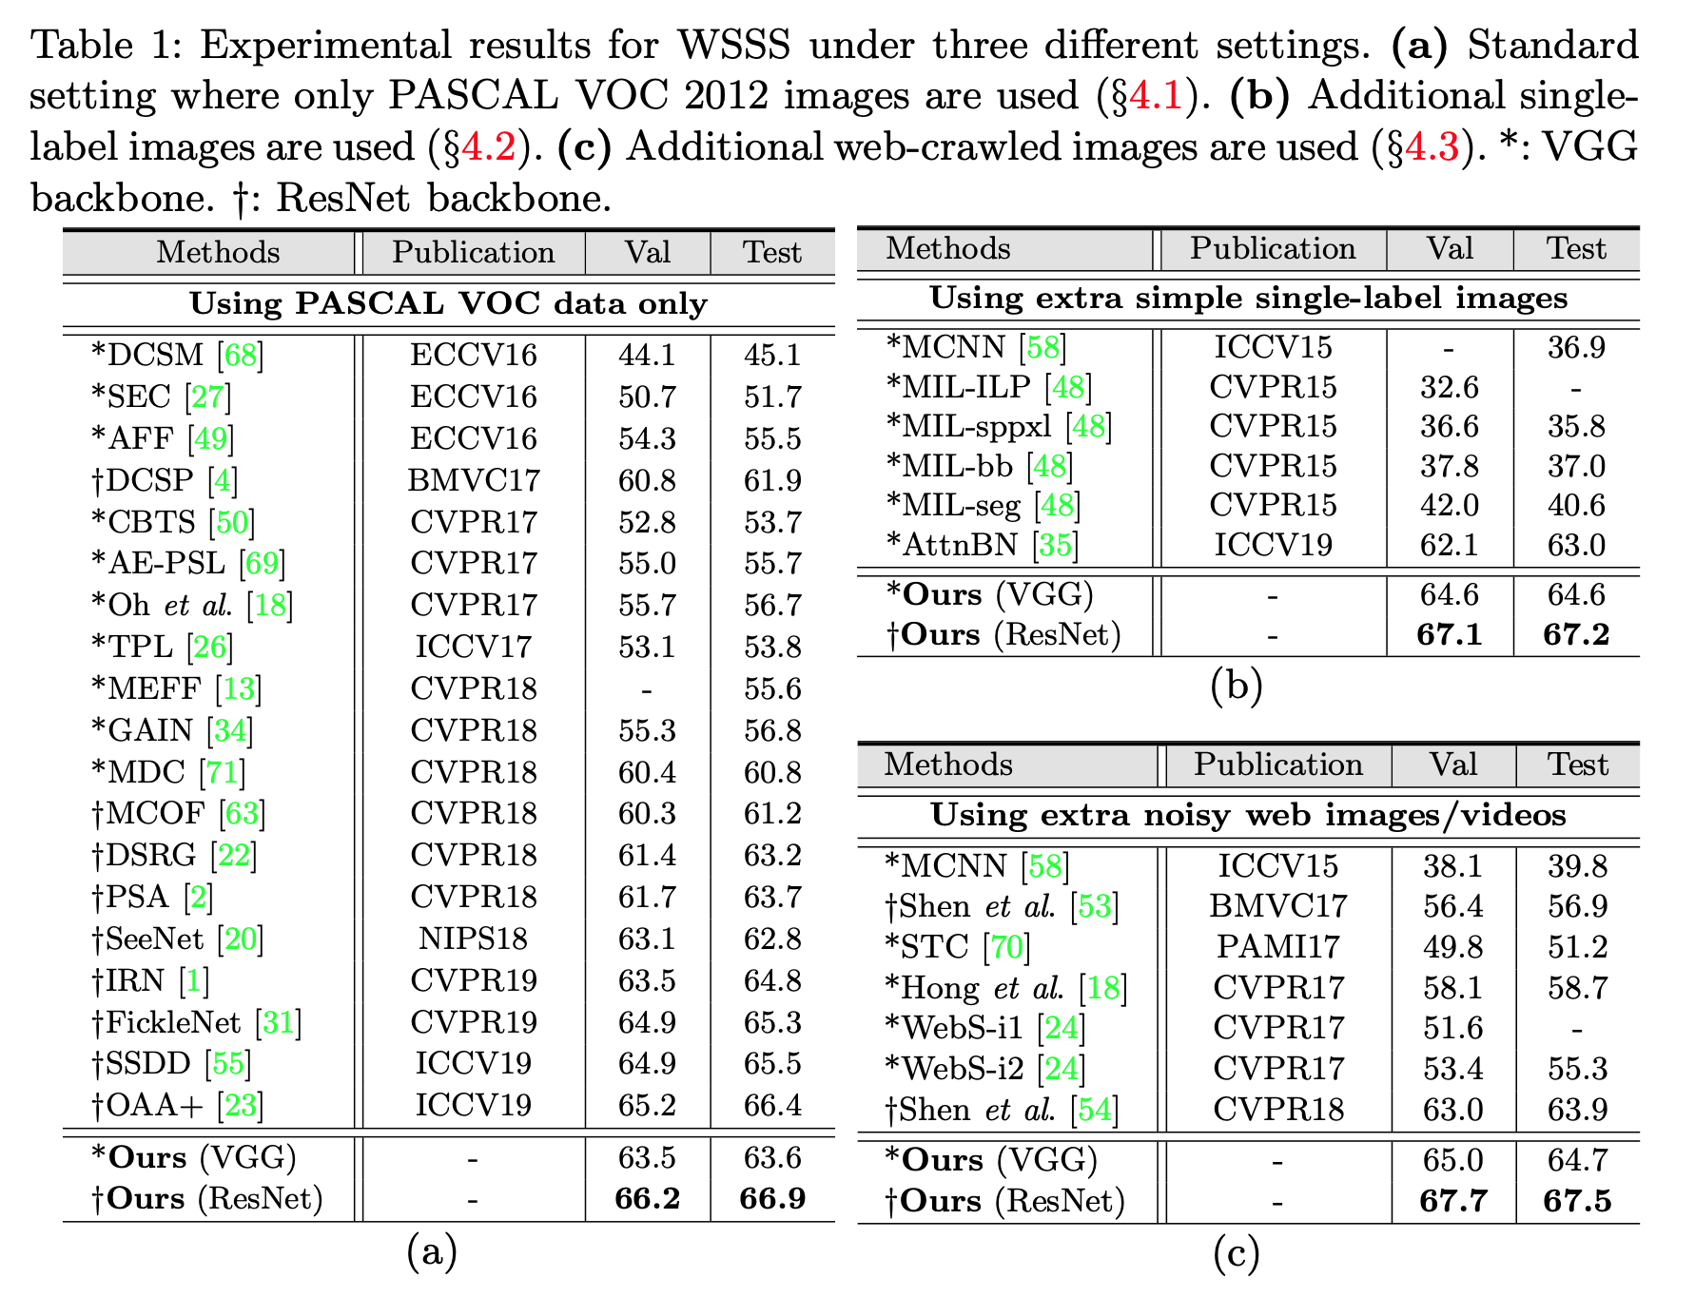
Experiment

Slide 16
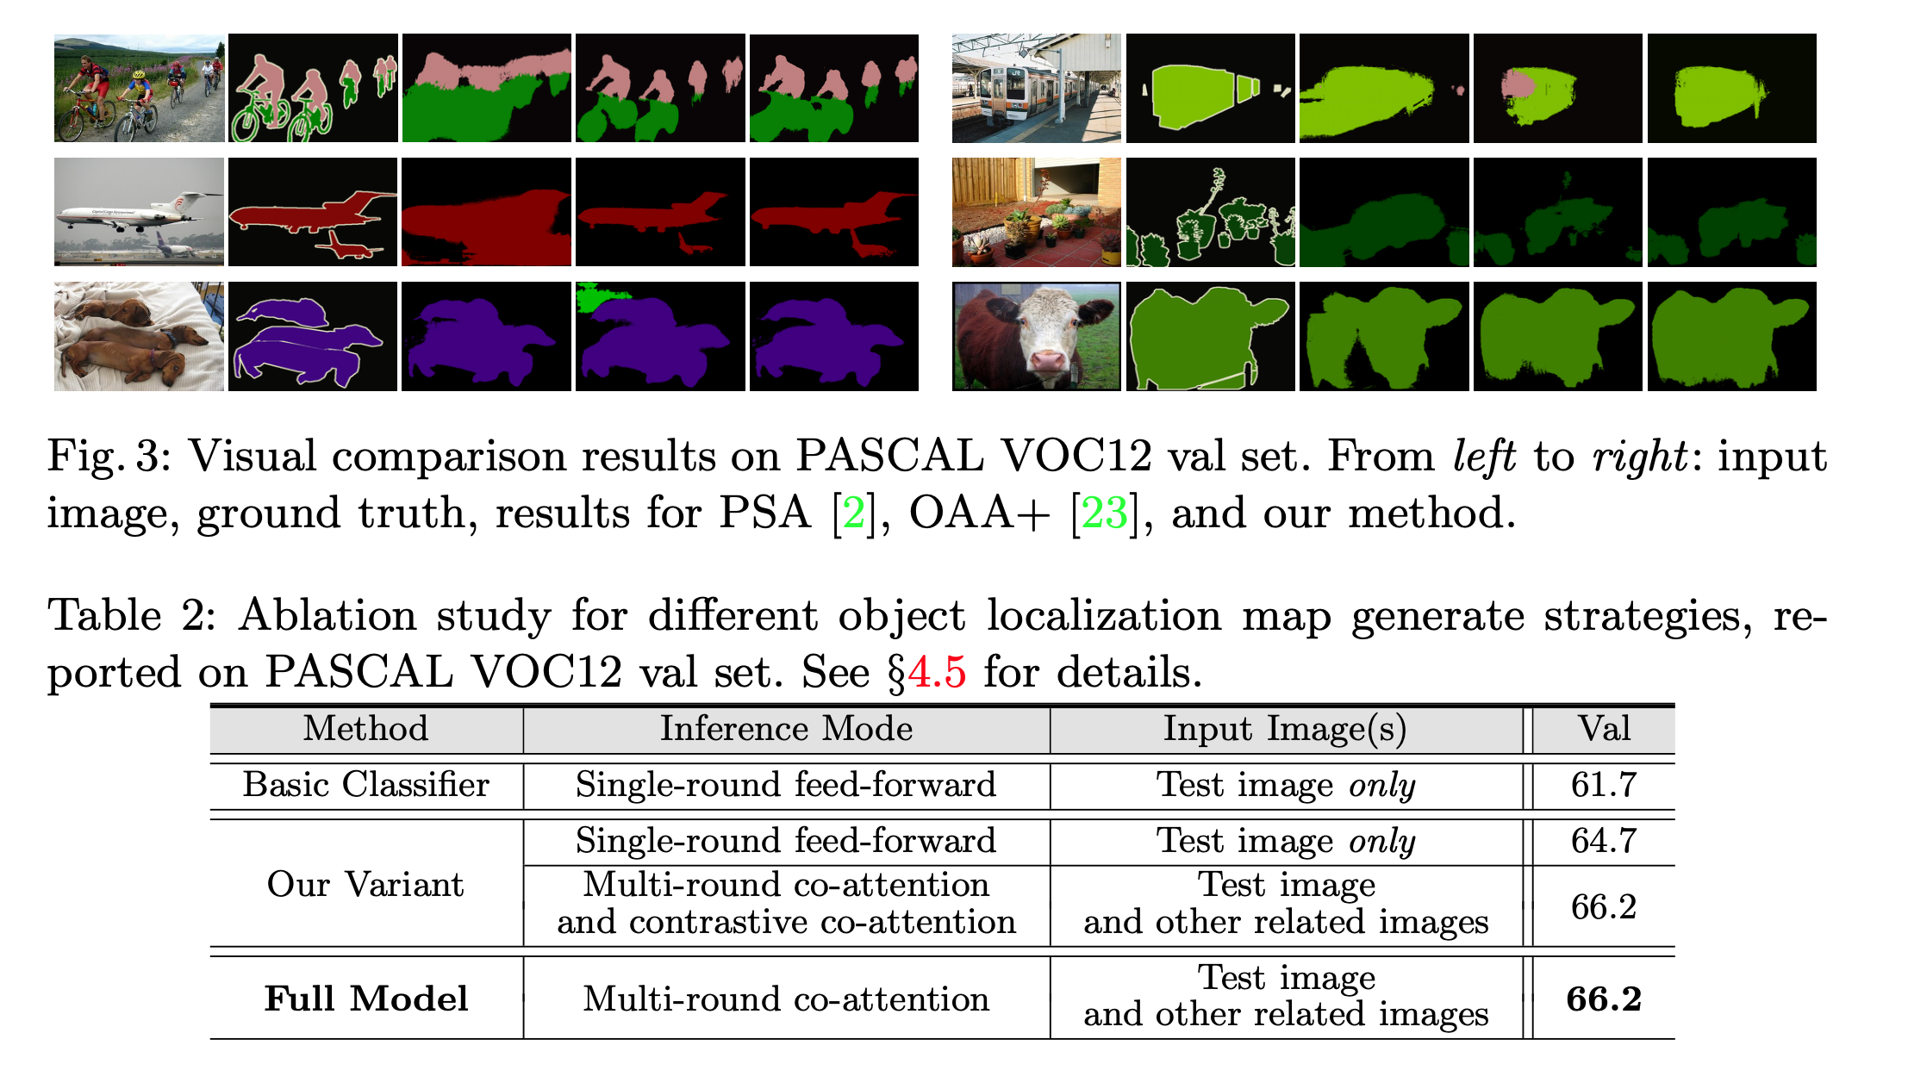
Experiment

Slide 17
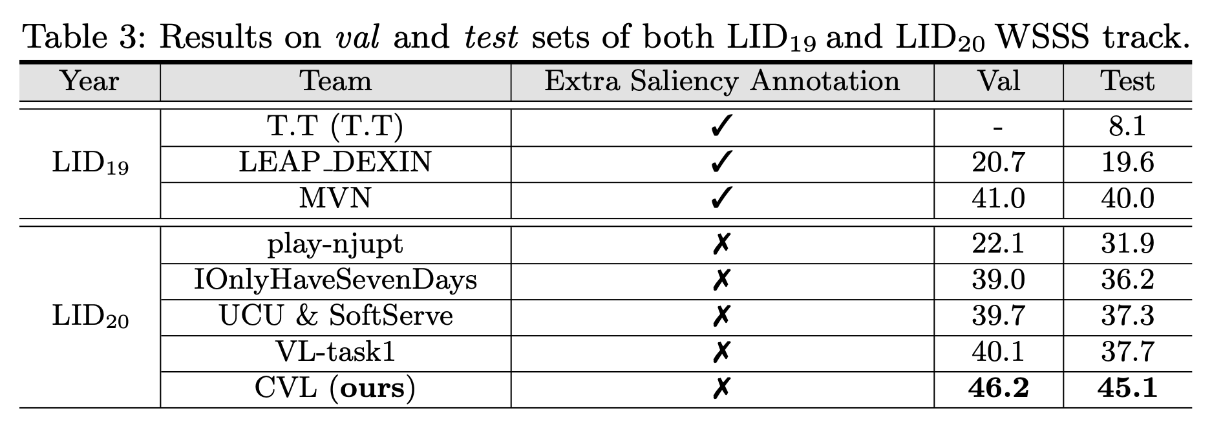
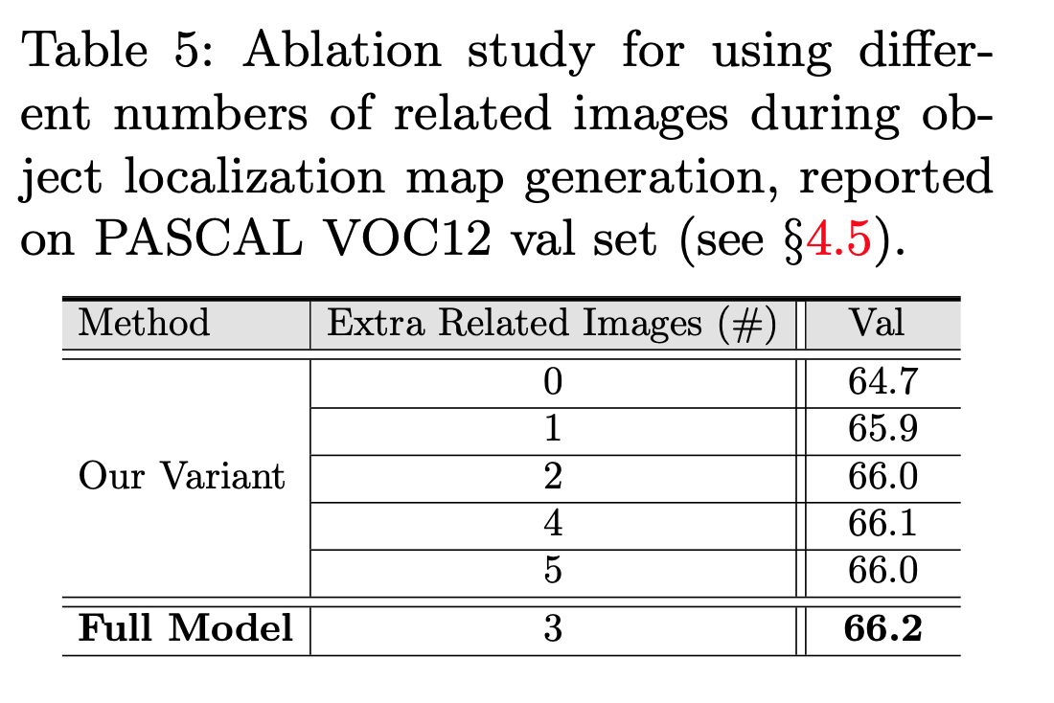
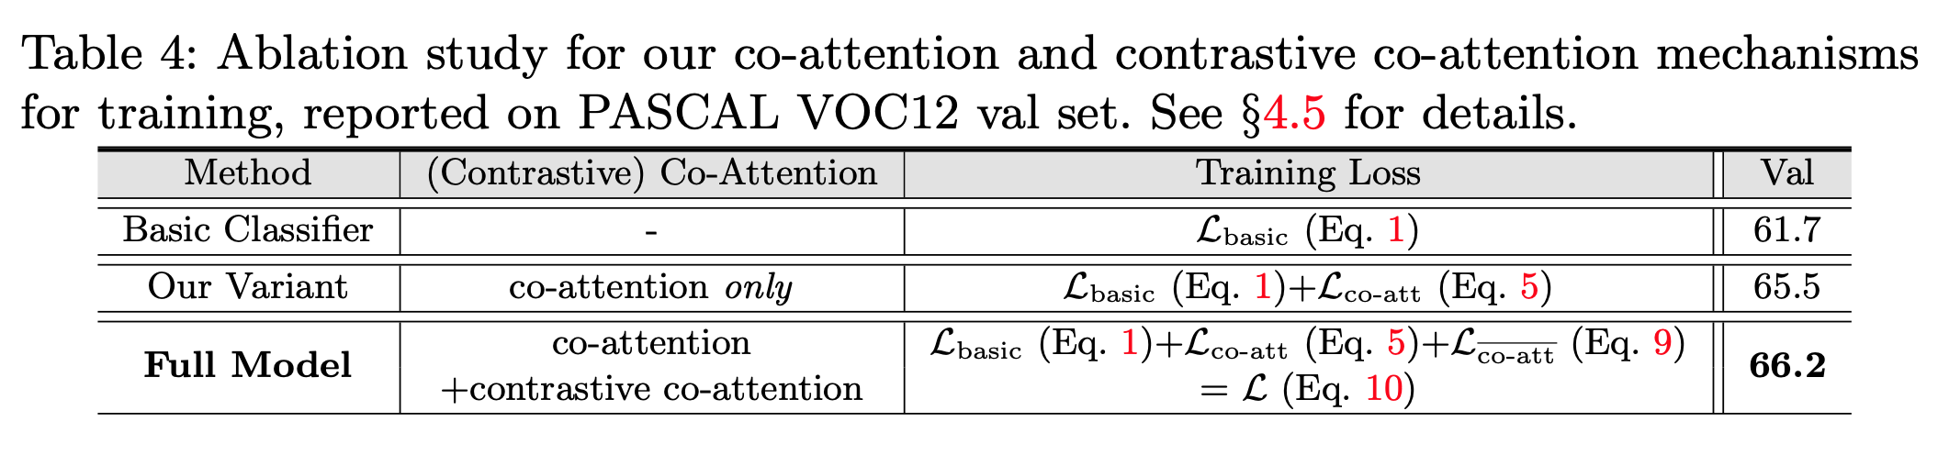
Experiment

